Slide 1

London Marathon 2023

Slide 2
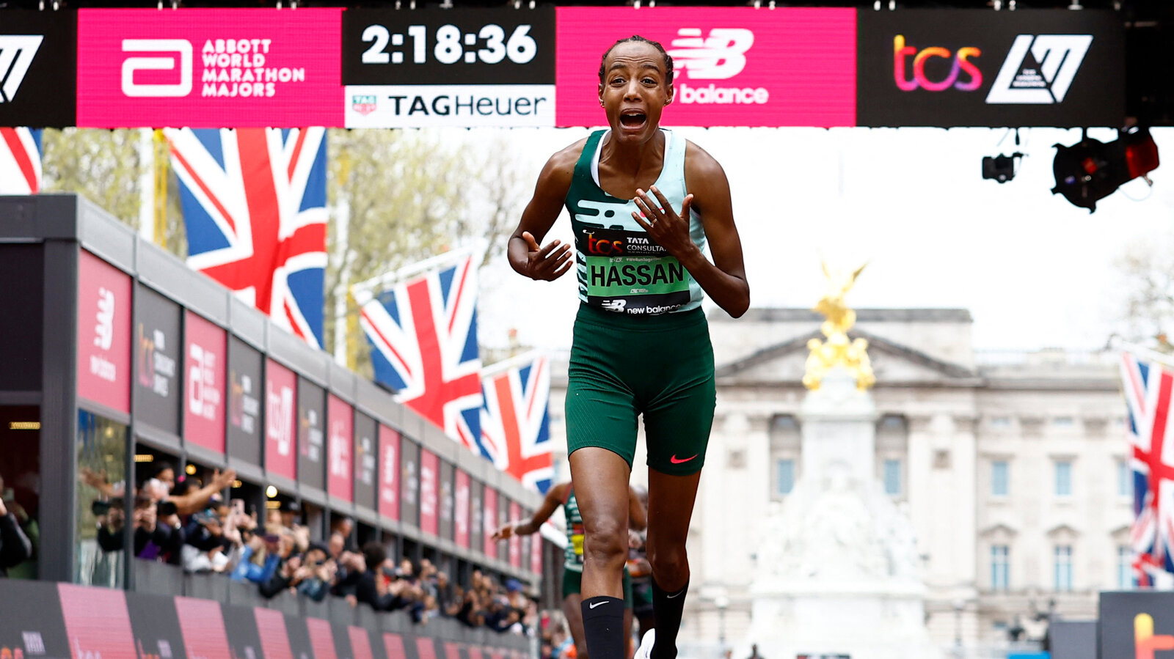
What strengths did Sifan show?
PHYSICAL?
(Body / fitness)
TRAINING HABITS?
(Commitment & Discipline)
TACTICAL?
(Race decisions / awareness)
TEAM PLAYER?
(Attitude/actions towards team-mates, competitors, coaches, support team)
MINDSET?
(Attitude, focus, managing emotions)
LIFESTYLE?
(e.g., Sleep, nutrition, hydration, rest & recovery, screentime)

Slide 3
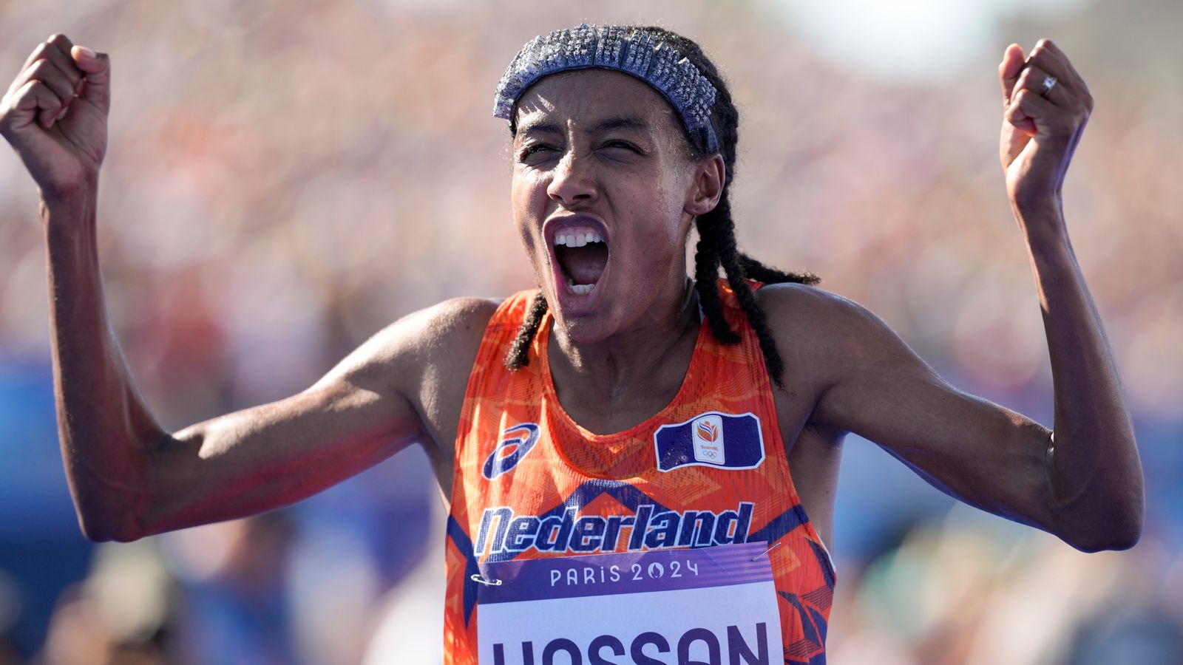
Sifan Hassan
“When I woke up this morning I was telling myself I was stupid to run a marathon, and what is wrong with me… I was so scared I even cried.”
“I wasn’t thinking about winning or how fast I was going to be ad I think that was a good thing for me today. I don’t challenge myself to be better than someone else, rather better than myself”.
“Challenging yourself is hard work, but its okay to be scared, have doubts and be worried. Just don’t run away and quit. The real race begins when the pain starts”.

Slide 4
What examples of STRENGTHS can you think of within these categories?
PHYSICAL?
(Body / fitness)
TRAINING HABITS?
(Commitment & Discipline)
TACTICAL?
(Race decisions / awareness)
TEAM PLAYER?
(Attitude/actions towards team-mates, competitors, coaches, support team)
MINDSET?
(Attitude, focus, managing emotions)
LIFESTYLE?
(e.g., Sleep, nutrition, hydration, rest & recovery, screentime)

Slide 5
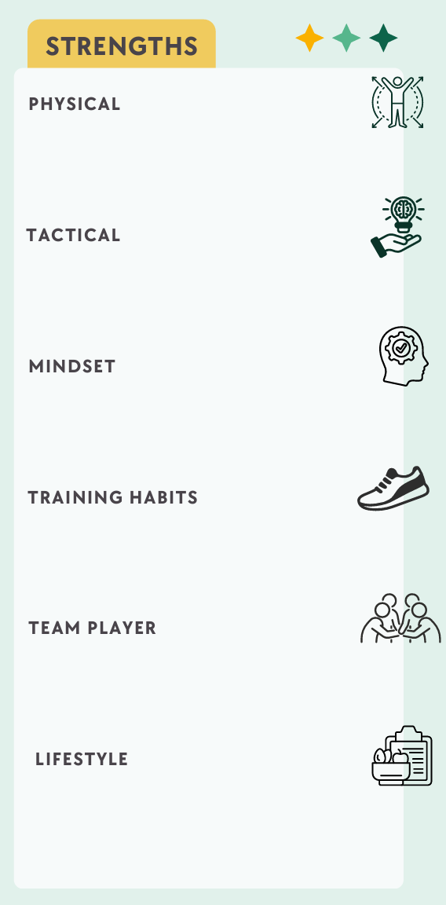
Write down your top strength in each category

Slide 6
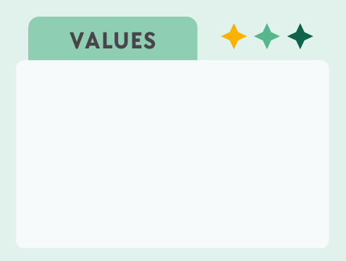
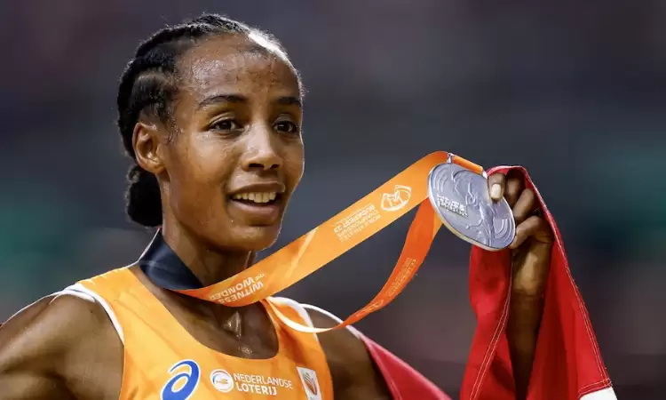
Values (what you stand for / what you want to be known for)
“I run because I love it. It brings me joy and fulfilment, and I want to share that with others.
Running has given me so much, not just as an athlete but as a person. It has been a way to connect with people, tell my story, and to show that no matter where you come from, you can achieve something meaningful.
I’m a very curious person… I really like a challenge. It motivates me.”

Slide 7
Values examples
Calm
Discipline
Bold
Consistent
Curious
Committed
Humble
Respect
Passion
Fun
Attacking
Role-model
Inner- strength
Driven
Connected
Honest
Proactive
Positive
Mastery
Fair
Dedicated
Learning
Gratitude
Effort
Adventure
Progress
Patience
Courage
Sportsmanship
Communication
Humour
Creativity
Reflective
Mindful
(Being ‘in the moment’)
Challenge

Slide 8
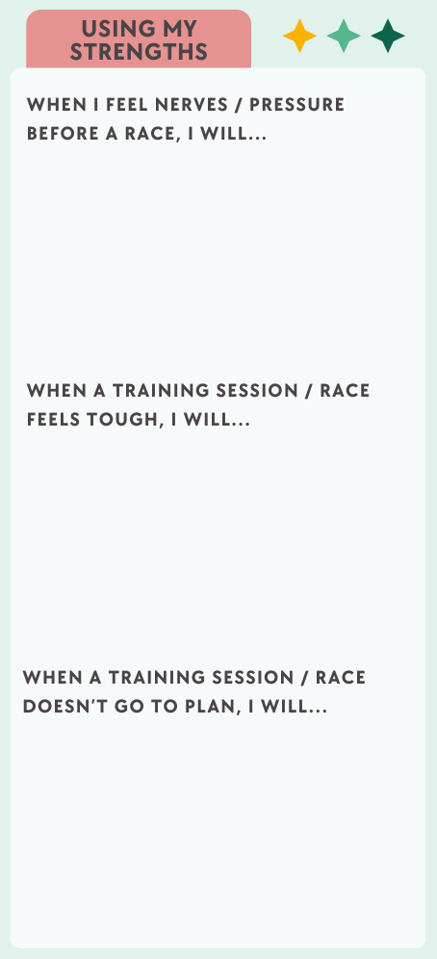
How can you use your strengths?

Slide 9
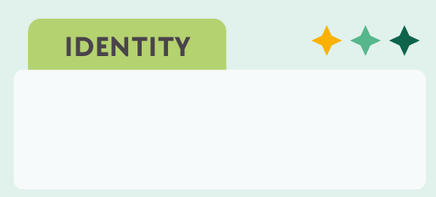
A bit of fun! – Your “Identity”
King / Queen of the mountain
Negative split Ninja
Quiet Assassin
Sprint Sniper
Comeback Kid
The Diesel
Strong kicker
Hill Demon
Consistency Champ
Relay Rockstar
Recovery Pro
Turbo Charger
Mud Mastermind
Cool as Ice
Endurance engine
Goal Getter
Hype Hero
Training Warrior
Laser-focused
Tactical Titan
Balance Boss

